Slide 1


IE6600 Computation and Visualization for Analytics
Group Project: Team 3
VARUN KUMAR
SATYAJIT LANKA
SHRIRAM VIJAYKUMAR
SARAVANAN ARUMUGAM

Slide 2
Overview
3-1-1 data based on the City of New York
3-1-1 was created for non-emergency municipal services, so that 9-1-1 can handle emergencies.
First started in Baltimore Maryland at 1996, this was later implemented in NYC on March 09, 2003. Data became open source since 2010.
180 languages, 60000+ customers, 7700+ daily requests, 2,76,827 highest calls in a day via call, text, app, and website.

Slide 3
Project Objective
To create a comprehensive interactive dashboard to visualize the 3-1-1 Dataset of New York City
To evaluate impact of Covid-19 on various municipal complaints
To compare multiple variables affecting these complaints in different period of timelines

Slide 4

Dataset
NYC 311 - data from 2010 to Sept 26, 2022
31,132,855 records with 41 columns (fields)
500+ types of complaint
Source: nycopendata.socrata.com
https://portal.311.nyc.gov/
Texting
311 - 692
Mobile App

Slide 5
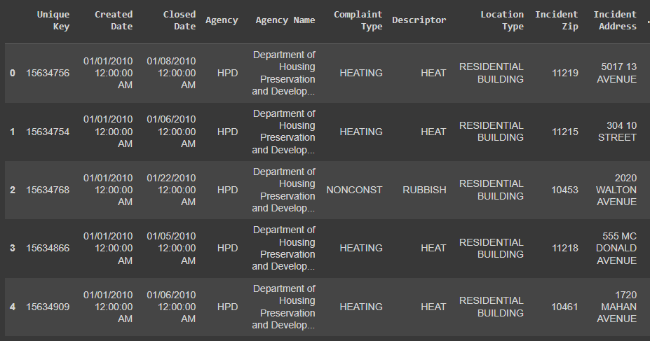

Slide 6
Methodology
Data cleaning and handling missing values with Python
Data Storage with Google BigQuery or Microsoft Azure
Data Querying with MongoDB or MySQL
Visualization with Tableau

Slide 7
Expected Results
Interactive dashboard to visualize 3-1-1 NYC complaint data
Extract interesting insights to evaluate the impact of COVID-19
Understanding the pattern of social behaviour of humans with respect to complaints in a Pandemic

Slide 8
TimeLine
Data Collection
Data Preparation
Exploratory Data Analysis
Data Visualization

Slide 9
THANK YOU

